Slide 1


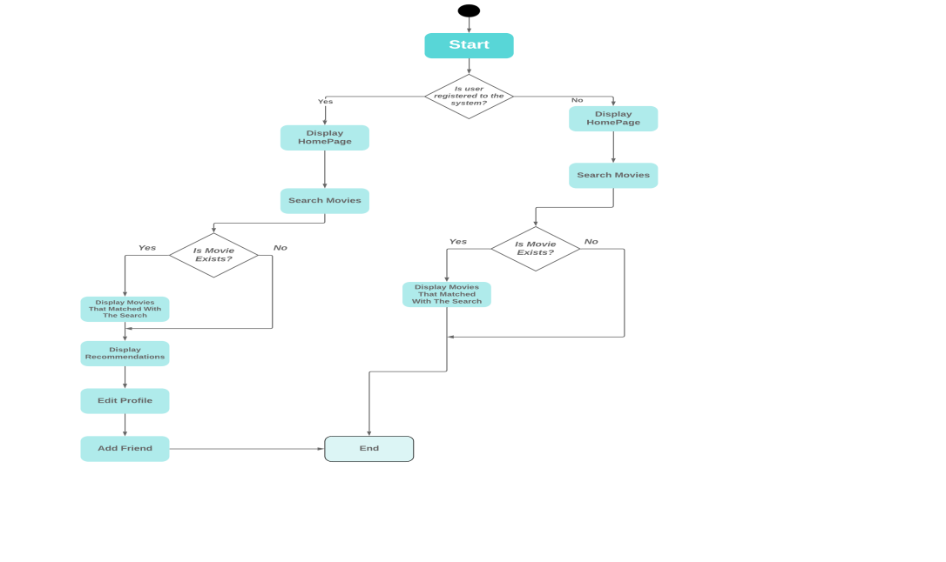
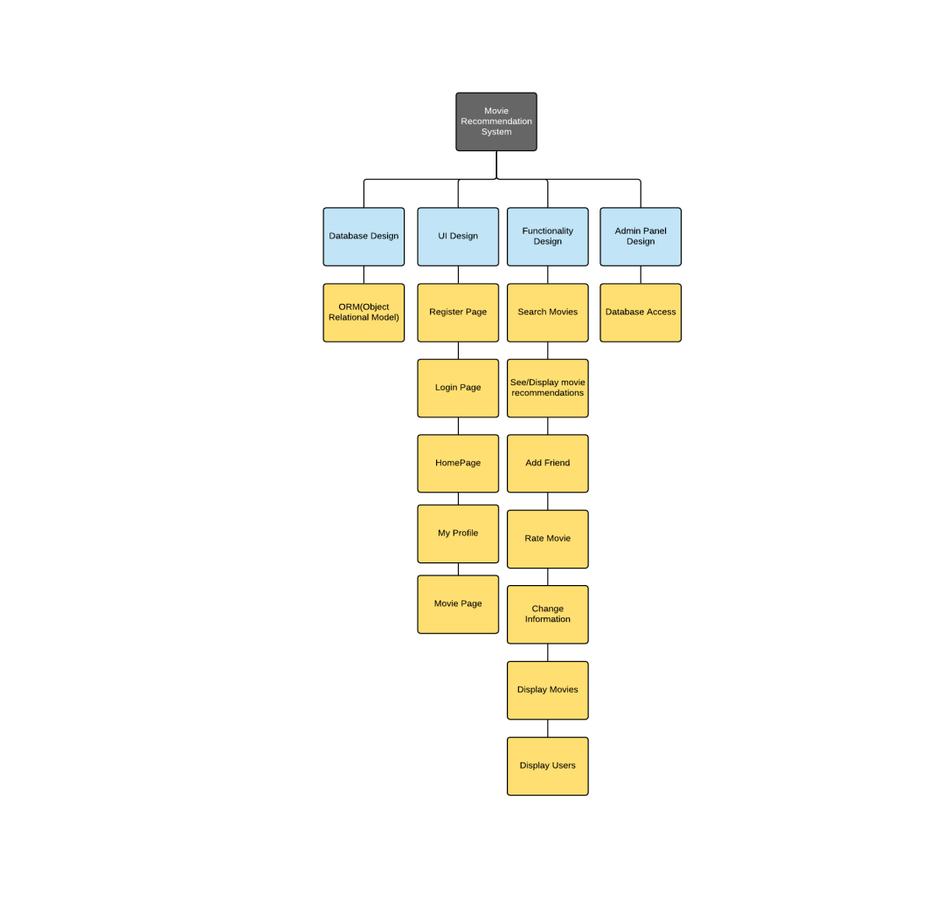
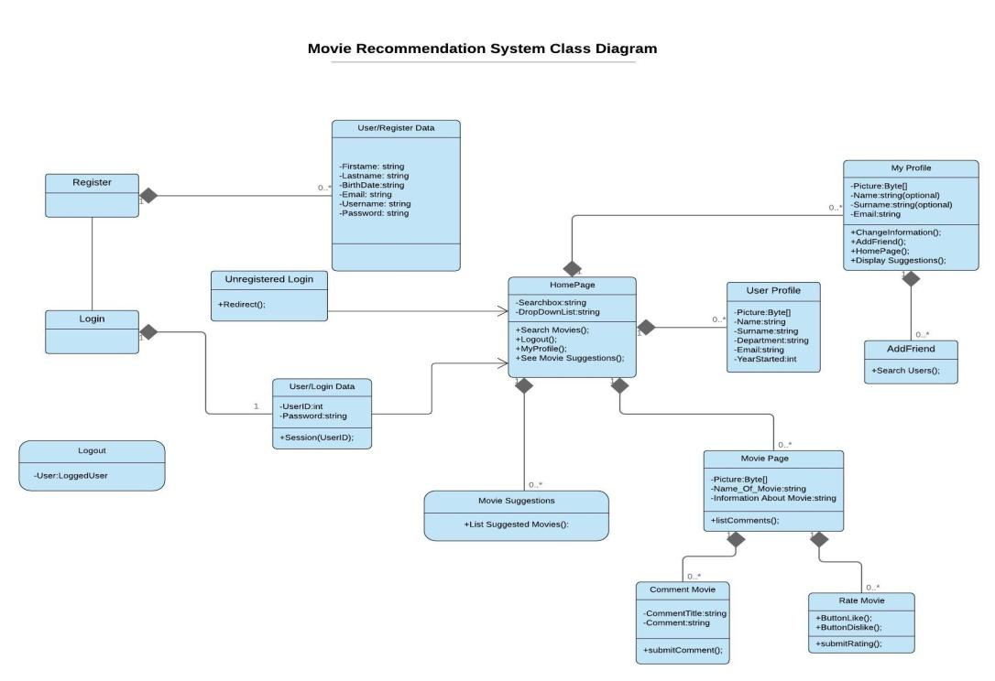
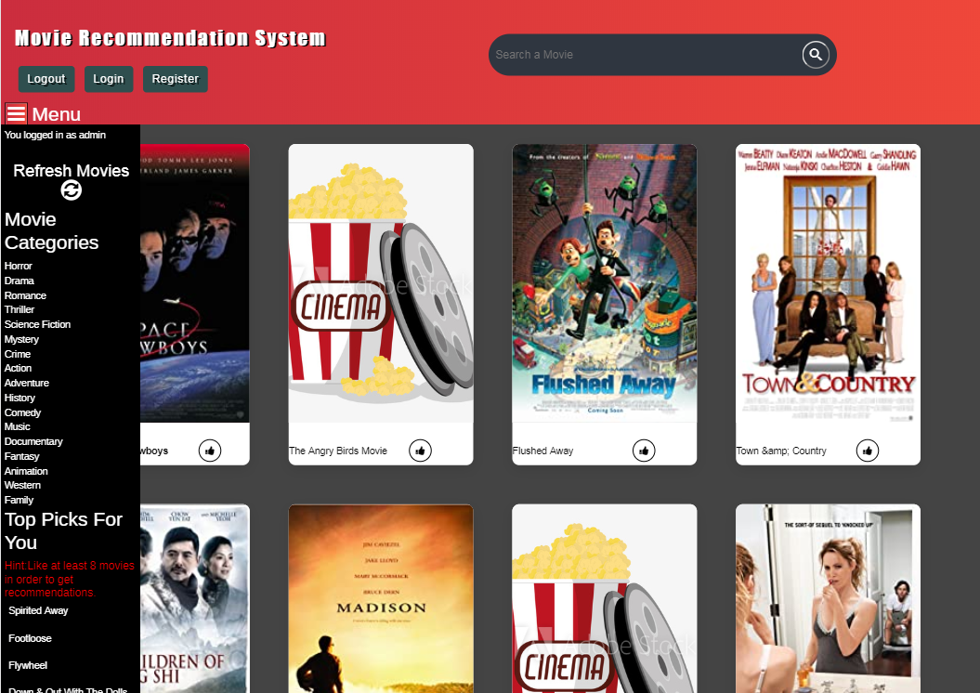
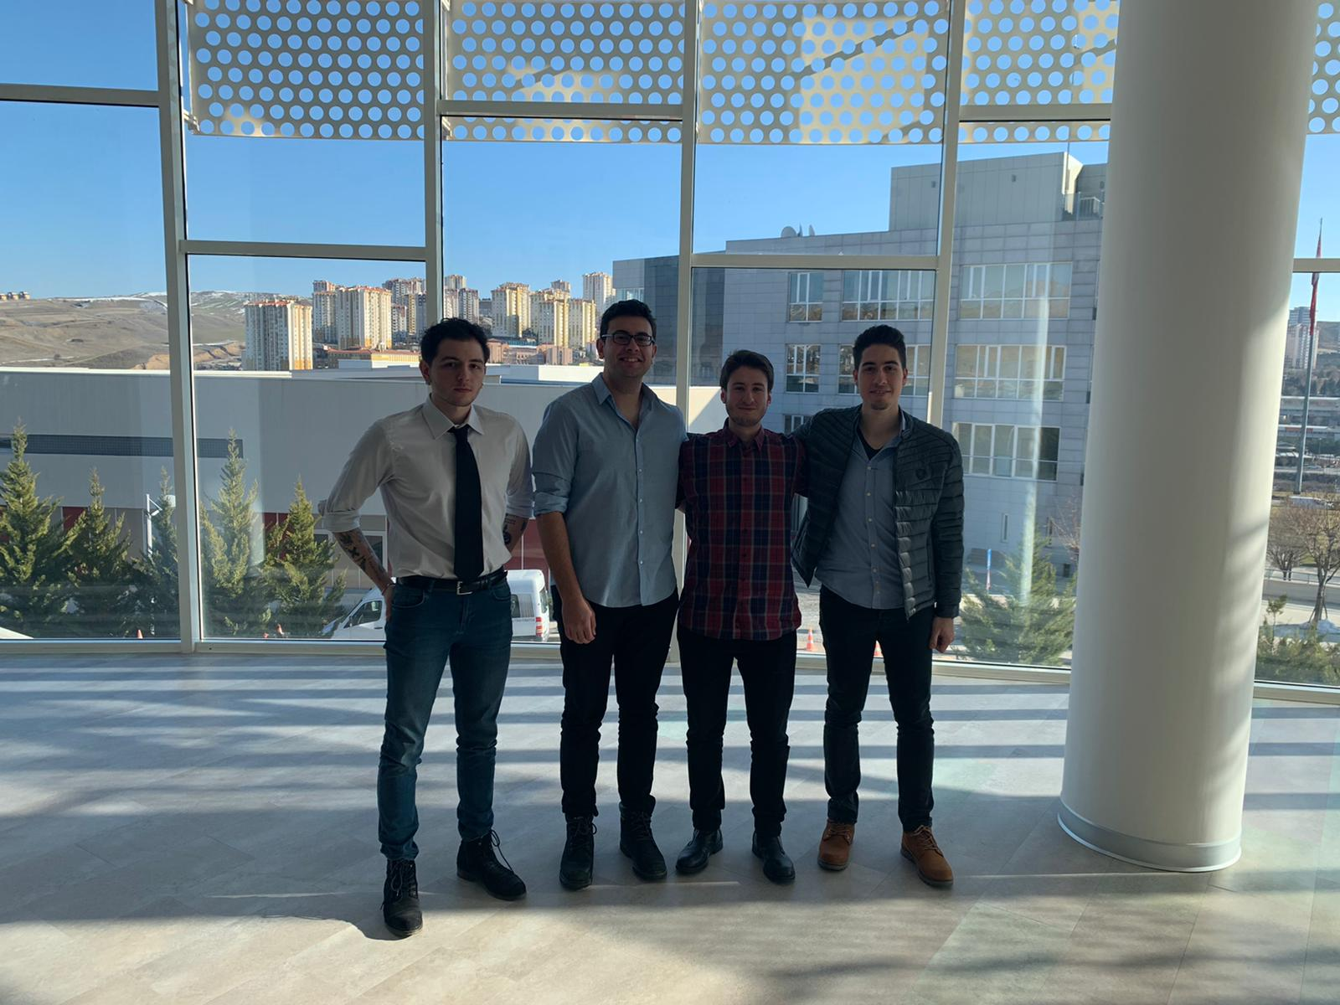
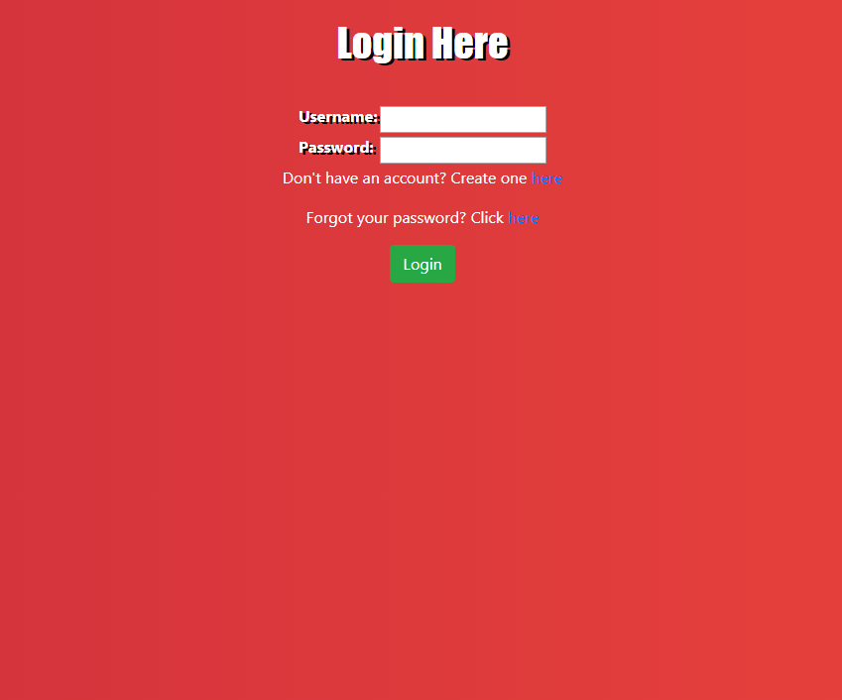
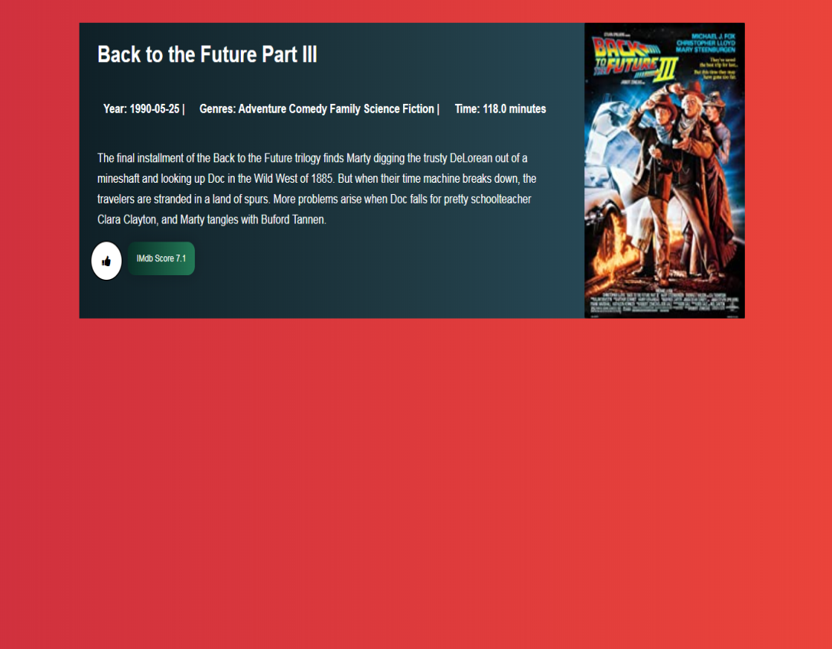
MOVIE RECOMMENDATION SYSTEM
A web based movie recommendation system
Doruk GÜRSEY–Kaan ÖNDER
Kemal Berke SAKA-Önen Emre CAN
Advisor: Assist.Prof.Dr. Abdül Kadir GÖRÜR
Çankaya University, Department of Computer Engineering
Abstract
The aim of this project is to develop a system that can offer movie advice to people looking for movies they like or looking for similar ones they love. In this document, we will present to you what is our project will bee look like, what are the algorithms that we may use and who uses these algorithms.
Introduction
Over the past 5 years, watching movies and series on digital platforms is now a part of our lives. While the film industry is slowly losing its influence, watching movies on the Internet and paying less for it is becoming a better and easier method for everyone. With the increase in our internet speeds, we are now able to watch movies or series from various platforms very comfortably. Some companies that foreseen this development have increased their investments in this field and have become the pioneers of this sector.The internet movie watching sector has increased over the years and will continue to increase at the same speed.
Figure 1 – Activity Diagram
Figure 2 – Use case realizations
Results & Conclusion
With this project, after people add the movies they like to their lists, they will be able to use a system that recommends them based on the movies they like.As the number of movies in Dataset increases, this system will work better and more efficiently. Django and Python have been the two most important keys in our project. Especially python made our work really easy.We are sure that we will recommend the movies that users will like with the algorithms in Python.
Figure 3 – Class Diagram
Solution
Our aim is to develop a software called "Movie Recommendation System", which is a web-based application that uses various prediction algorithms(machine learning) to propose their users' new movies according to their movie tastes. Also, the web-based application will be compatible with mobile devices too. The purpose of this project is to help people to find new movies to watch and share their movie interests with other people and with their friends.
Acknowledgement
We would like to thank our advisor, Assist.Prof.Dr. Abdül Kadir Görür for his guidance.
Figure 4 – Finished Product
Figure 6 – Finished Product
Figure 5 – Finished Product
Figure 7– Project Members

